Slide 1
Research Paper: Adoption Factors of Artificial Intelligence in Human Resources Management (HRM)
CSE 431
Team 26
S.M Toufique• 19201141
Consultants: Farhadul Islam (ST) & Sabbir Hossain (RA)
Tuffaha, M. & Perello‐Marin, M. R.(2022). Adoption Factors of Artificial Intelligence in Human Resources Management. Future of Business Administration, 1(1), 1-12. https://doi.org/10.33422/fba.v1i1.140

Slide 2
Overview
Context
Introduction
Methodology
Results
Conclusion

Slide 3
Context
AI in HRM
Turnover prediction with artificial neural networks
Candidate search with knowledge-based search engines
Staff rostering with genetic algorithms
HR sentiment analysis with text mining
Résumé data acquisition with information extraction
Employee self-service with interactive voice response

Slide 4
Goal
Identify the adoption factors of six scenarios of AI in HRM.
Explore Insights for practitioners and academics with AI adoption in HRM
Determinants Factors
Compatibility
Relative advantage
Complexity
Managerial support
Government involvement
Vendor partnership

Slide 5
Introduction
Literature
Artificial intelligence (AI) is considered the most advance development in HRM technologies (IBM, 2020)
analysing employee behaviors, attitudes and emotions that affect job performance(Todolí-Signes, 2019)
Challenge and Objective
driving factors for AI adoption in HRM are still unclear(Lengnick-Hall, Neely, & Stone, 2018)
It is important to highlight the success factors that offers a framework to explore AI adoption in HRM (Chen, 2019)

Slide 6
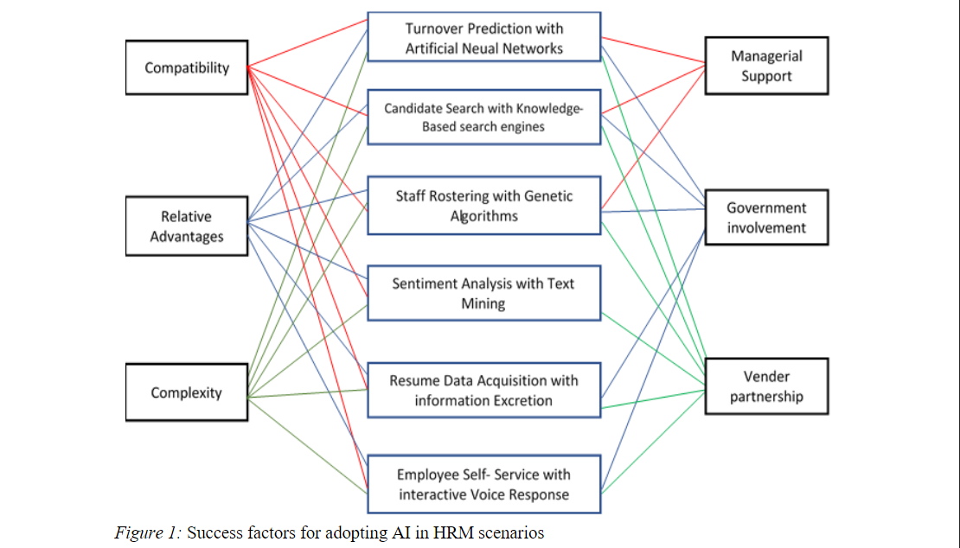
Other factors or scenarios could be added, but this piece of research is built on the previous work done by Chen (2019) and Strohmeier and Piazza (2015)

Slide 7
Methodology
Join two different research streams in order to aggregate knowledge and to identify common patterns
The first part of this paper serves as a theoretical foundation by pointing out the conceptual frame of AI and their building units
The second part describes AI scenarios in HRM
The third part build the relationships between adoption factors and scenarios.

Slide 8
Results and Findings
Part 1
AI aims to reproduce human mental activities with the support of machines, in areas such as understanding, perception or decision(Lexcellent, 2019)
Deep learning and Machine learning are the basic building units of AI.
Part 2
The application scenario of text mining in HRM is sentiment analysis(Strohmeier & Piazza, 2015)
Through Information extraction (IE), analysis could be done automatically by extracting relevant information from the resume.

Slide 9
Results and Findings
Part 3
compatibility has a positive influence both, on IT adoption general,and on AI in particular (Verma & Chaurasia, 2019
relative advantage has a significant effect on the adoption of AI (Mahesh, Vijayapala, & Dasanayaka, 2018
Literature claims that by minimizing the complexity of AI technology, the adoption rate could be increased(Lu, Luo, Wang, Le, & Shi, 2015)

Slide 10
Results and Findings
Part 3
Literature deals with managerial support as significantly influence attitudes towards AI adoption (Awiagah & Lim, 2015)
Cheung, & Messom (2018) claim that government policy and legislation can encourage AI diffusion
Companies achieve competitive advantages through inter and intra-organizational collaboration(Ali & Khan, 2016).

Slide 11
Conclusion
Insights
Factors analysed directly affected the HRM scenarios.
study analyzes and explains the adoption factors of AI in Specific scenarios of HRM based on previous literature.

Slide 12
Further Research
Further study to analyse in detail how AI is being implemented in big companies based on the model presented in this paper
Whether there are differences between implementation by business sectors or geographical areas
Other Success factors may be considered for AI diffusion

Slide 13
Thank You

